Slide 1
Feature Engineering and Feature Selection

Slide 2


Please Allow Me to Introduce Myself
Educational Background:
Graduate of SMU MSDS – August, 2017
Where I Work:
Data Scientist, Research and Development Group, Office of the CIO
20th Largest Privately Owned Company in the US
Companies include Southeast Toyota, Southeast Toyota Finance, JM&A
World’s Largest Distributor of Toyota; 22% Market Share of Toyota Sales in the US
Ranked by Fortune Magazine for the last 20 consecutive years as one of the 100 Best Companies to work for and also named by Fortune as one of the 10 Best Companies to Retire From

Slide 3
Feature Engineering

Slide 4
What is a Feature?
A feature is a predictor used in a machine-learning model

Slide 5
What is Feature Engineering?
Feature Engineering is the process of handcrafting new predictors using existing data elements that allow models to more accurately perform

Slide 6
Types of Feature Engineering Approaches – Categorical Features
One-Hot Encode: Involves creating a dummy / binary variable from a text categorical feature, where the text value is used in the column header and the values in the new feature are encoded using the binary values of 1’s and 0’s.
Benefits:
Converts categorical data into a form that the model can better use for predictions
Negatives:
Creates sparse data when a categorical feature has many distinct values
Causes challenges on imputing missing values, given the binary nature

Slide 7

Types of Feature Engineering Approaches – Categorical Features
Supervised Ratio: The new feature represents the percent of positive labels for the corresponding value in the categorical variable.
${SR}_{i}$ = $\frac{P_{i}}{N_{i}±P_{i}}$
Example: We’re building a model to predict customer churn. One of our features is Zip Code. In zip code 35234 there are 100 customers, and 10 of them churned.
Therefore, $P_{i}=10$ and $N_{i}$ = 90.
Supervised ratio in zip code 352434 = .10
Notes:
When working with data that has many distinct values, a downside of one-hot encoding is the feature explosion resulting when there are hundreds or thousands of distinct values. To deal with this, a supervised ratio can be used.

Slide 8

Types of Feature Engineering Approaches – Categorical Features
Weight of Evidence: This feature develops a monotonic relationship with the response variable and has been used in credit scoring for categorical variables. When deploying a model with a Weight of Evidence predictor on new data, the model will first run through the initial set of predictions and output the response variable. From that response variable, the weight of evidence variable can then be calculated.
$WOE$ =$ln\left(\frac{\frac{P_{i}}{TP}}{\frac{N_{i}}{TN}}\right)$
Note: TP = Total Positive, TN = Total Negative
Notes:
When deploying a model with a Weight of Evidence predictor on new data, the model will first run through the initial set of predictions and output the response variable.
From that response variable, the weight of evidence variable can then be calculated.

Slide 9

Types of Feature Engineering Approaches – Categorical Features
Weight of Evidence Example: Sticking with the customer churn model, zip code 35234 has 100 customers and the prediction of churn is the response variable. After running the model, we had 10 predictions of those 100 customers will churn in 35234. In total across all zip codes, our model predicted 1,000 customers will churn and 10,000 will not churn. So, can we convert the zip code column to represent if the count of customers who will churn will be above or below average for a given zip code?
Therefore, $P_{i}=10$, TP = 1,000, TN = 10,000 and $N_{i}$ = 90.
Weight of Evidence Value for zip code 35324 = .105
Notes:
The positive value identifies this zip has an above average churn rate.
When retraining this model in the future, the Weight of Evidence value for zip codes can be recalculated and this allows the user to see the effect of population drip in a zip code on churn.

Slide 10
Extraction of Statistical Features in Time-Series
Begin with an initial base of predictors
Set the time series interval to be used through A/B testing
Missing data handled through imputing the mean value for the time series into observations with missing data
Feature engineering through the extraction of statistics from time series with TSFresh
Notes:
From the initial 18 predictors, over 15,000 time series predictors are engineered through TSFresh.
The Library Used TSFresh: Python library used to extract characteristics from time series.
Mean
Absolute Sum of Changes
Percentile Value: 30th, 80th
Longest Days Above Mean
Standard Deviation
Non Linearity 1, 2 and 3 Day Tests
Variance
Absolute Energy
Kurtosis (Peak Sharpness)
Maximum Value
Variance (With / Without Absolute Value) Change in Percentile Range:0% - 60%, 60% - 100%, 0% - 80%, 0% - 100%, 0% - 40%, 20% - 60%
Variance Intercept for 5 Day Linear Trend

Slide 11
Interactions
Libraries Used:
XGBClassifier: XGBoost algorithm for classification tasks
Xgbfi: Python library which ranks features as well as feature interactions by different metrics from the XGBoost algorithm
Pairwise and Three Way Interaction of Features Inclusive of:
Addition
Subtraction
Multiplication
Division
Notes:
Next we looked at creating new features through interactions. To evaluate if an interaction was a successful predictor in a model we us the XGBoost classifier, which provides variable importance ratings.
XGBoost is an implementation of gradient boosted decision trees designed for speed and performance.
Gradient boosting is an approach where new models are created that predict the residuals or errors of prior models and then added together to make the final ensemble model prediction. It is called gradient boosting because it uses a gradient descent algorithm to minimize the loss when adding new models. The biggest difference between XGBoost and a Gradient Boosting Machine is the performance improvements of XGBoost as a result of the parallelization of XGBoost.
XGBoost is known to be one of the best machine learning frameworks, using a boosting technique that provides ensemble learning through a process of building many models sequentially, with each model attempting to correct for deficiencies in the previous model. The boosting technique fits many large or small trees to reweighted versions of the training data. The classification is made by a weighted majority vote.
Before the selection of final features, pairwise and three way interactions were performed. XGBfi is a library that outputs the expected gain values and rankings of the most significant three way interactions.

Slide 12
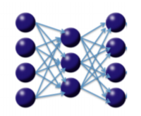
Using Deep Learning for Creating a Feature Identifying Anomalies
Deep Learning can also be used for unsupervised feature learning or, more specifically, nonlinear dimensionality reduction (Hinton et al, 2006)
Autoencoders perform unsupervised learning capable of learning efficient representations of the input data through dimensionality reduction, similar to Principal Components Analysis
Reconstruction Error Calculated Through Backpropagation to Generalize PCA
3 Layer Autoencoder
Notes:
- Autoencoders are powerful unsupervised learning algorithms, which are getting popularity in fields such as anomaly detection or feature engineering, using the output of intermediate layers as features to train a supervised model instead of the raw input data.
- Unsupervised means they do not require labels or ground truth to be specified during training. They just work with whatever data you put as input as long as the network has enough capability to learn and represent the intrinsic existing relationships.
- Principal components analysis performs dimensionality reduction on a linear manifold. A deep learning autoencoder uses backpropagation to generalize principal components analysis, but the non-linear layers of the deep neural network performs dimensionality reduction on a curved manifold, which is a much more powerful representation of the data than the linear manifold that is used by PCA.

Slide 13

Non-Linear Dimensionality Reduction Through a Stacked Autoencoder
Input
41 Units
Hidden 1
30 Units
Encoder
Hidden 2
15 Units
Code
Decoder
Hidden 3
30 Units
Reconstruction Mean Square Error Calculated Per Observation
Output
41 Units
Example 5-Layer Stacked Autoencoder for Anomaly Detection
Notes:
The Stacked AutoEncoder sandwiches the code layer in between the initial encoder and decoder layer.
The reconstruction Mean Squared Error is passed along as an added feature to the final model. This added feature was a statistically significant predictor, as it was ranked 24th out of the 42 predictors.
All observations above the threshold for outliers are dropped in the final model and the reconstruction mean square error for each observation serves as an additional predictor in training the model
The threshold for outliers was determined by setting a top whisker to the boxplot of the Reconstruction Mean Square Error Vector. This top whisker is set by adding the 75th percentile + a multiplier to the interquartile range
The value for the multiplier is determined through iterative A/B testing
The selection of three hidden layers with the above amount of units was arrived through a cartesian grid search which found the optimal number layers and hidden units for the autoencoder to best reconstruct the data.

Slide 14
Architecture Engineering
Factors to Consider in Class Architecture:
How Many Classes
Test Schemes with Varying Counts of Classes
Class Separation Thresholds
Review Class Separation Thresholds at Different Ranges by Viewing:
Distribution Plots
Mean Value of Features for Each Range of Thresholds to Maximize Inter-Class Variance
Notes:
The goal is to optimize recall of the most at risk class, while minimizing false alarms where the algorithm identifies a False Positive
Class architecture design is an iterative process, where many different architectures should be contemplated, with review of the plots and mean values in an architecture and then retesting another architecture.
To identify the count of classes and thresholds, review the distribution of predictors over time, such as the time series bar chart shown two slides previous. Is there a shape of the distribution that shows a consistent time where break points occur in the data across multiple predictors? If yes, this will be beneficial to set the class thresholds at these points. Also, of equal importance is creating a pivot table of the data where the fall classes are the columns and the rows are the predictors with the mean values for each fall class threshold. Test different class counts an break points until you can maximize inter-class variance.
By maximizing inter-class variance in the architecture, it will make the classifier more successful in avoiding misclassification errors. Additionally optimizing class architecture can correct problems where the classifier is optimizing on the wrong class, such as the majority class when you want it to optimize recall on the minority class.

Slide 15
Feature Selection

Slide 16
Variable Importance Rankings
Variable importance rankings from an initial XGBoost classifier used in feature selection
Two and three way interactions were engineered. Calculating every combination of three way interactions is computationally expensive!
The final model used 40 features that were selected through the XGBoost feature selection process.
Notes:
The Xgbfi library is valuable as the computation overhead to do three way interactions on even 30 features becomes problematic.
On our dataset, performing every combination of 3 way interactions on 30 predictors was over 380,000 predictors. However, XGBFi can come to the rescue, as it reduced the calculation time for identifying feature importance for three way interactions from over a week to minutes. Xgbfi calculates a list in descending order of expected gain values from all combinations of features in up to three way interactions.

Slide 17
After Feature Engineering a Big Net; Reduce
Hundreds of Thousands of Features
Inclusive of all combinations of 2-Way and 3-Way Interactions
Iteratively Eliminate Features Using Variable Importance Rankings
Final Selected Features
Requires A/B testing to determine when to stop feature selection process
Notes:
Bringing it all together… From the original set of predictors;
Begin with TSFresh for feature engineering.
Then, 2-way interactions are caluclated, and significant 3-way interactions using the Xgbfir library are identified and coded. A/B test using the top 3-way interactions using the gain metric and expected gain.
Gain is the Total gain of each feature or feature interaction
Expected Gain is the Total gain of each feature or feature interaction weighted by the probability to gather the gain (based on how likely that feature or feature interaction is to be encountered in the tree).
Then conduct Feature selection using variable importance rankings to reduce the count of selected time series features.
These top features are added to the dataset using feature selection from the feature importance ratings using the XGBoost classifier which ultimately resulted in the selection of 40 final features.

Slide 18
A/B Testing Using Consistent Seed Values
A/B testing is performed by conducting multiple iterations of machine learning modeling. Each iteration round of machine learning uses a consistently different seed value, where different seed values are tested
When testing a different multiplier, a consistent process of iteration rounds is used, with the same combination of seed values used in the splitting and oversampling/undersampling the data in each round
Notes:
When changing a component of the model (features, threshold for outliers, class count, time series duration, etc.), its critical to perform this modification singularly with all other variables holding constant. If you change more than one component or do not use a consistent set of seed values, you will be unable to decipher if the change of the model component had the impact on the results or if it was a result to the change in how the data was split. By using A/B testing, you will eliminate the possibility of a confounding variable being responsible for a change in the model performance.
In the instance of this dataset, there were four multiplier values tested with each multiplier value tested using four combinations of seed values for splitting and oversampling/undersampling

Slide 19
Case Study: Fantasy Football

Slide 20
Case Study: Fantasy Football Draft
Data Acquistion
Get 3 Sets of Data from ProFootballReference.com, one set for each of the position types
Download annual data for the primary statistics (approximately 35 initial features used, depending on the position)
Go back to 2001, to accumulate sufficient sample
Get additional data; i.e. average annual fantasy football draft position for the past 17 years

Slide 21
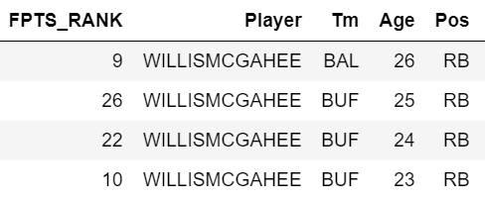
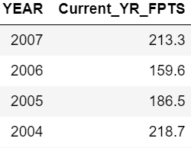
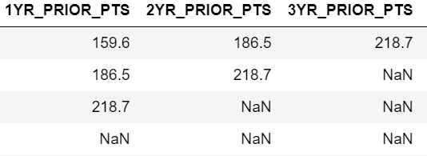
Case Study: Fantasy Football Draft
Data Wrangling
Load data into Pandas and Wrangle, i.e. use Pandas shift function to shift Current Yr FPTS to create additional columns.
Shift is a feature engineering method that is beneficial on time-series data

Slide 22
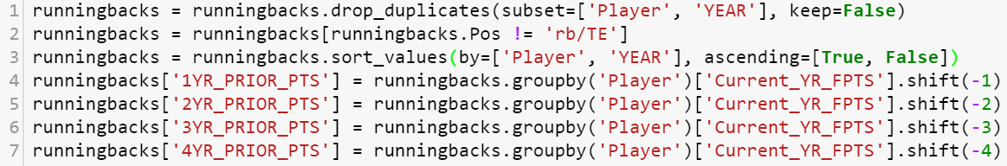
Case Study: Fantasy Football Draft
Data Prep / Feature Engineering
Example code for data prep and shifting:

Slide 23
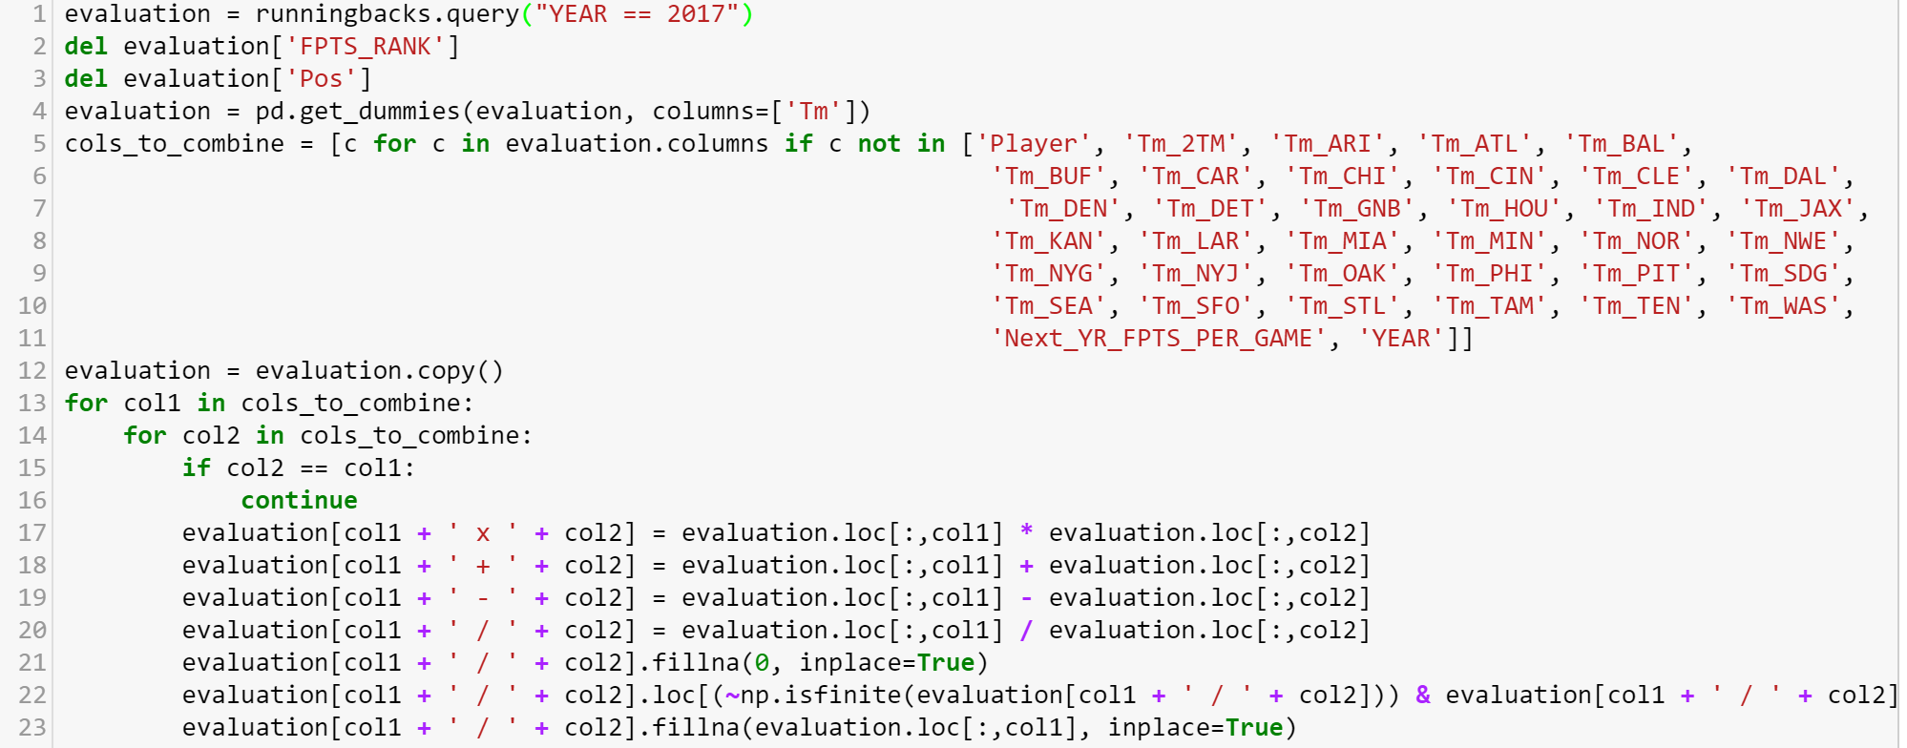
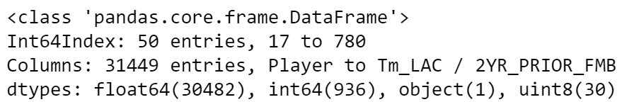
Case Study: Fantasy Football Draft
Data Prep / Feature Engineering

Slide 24
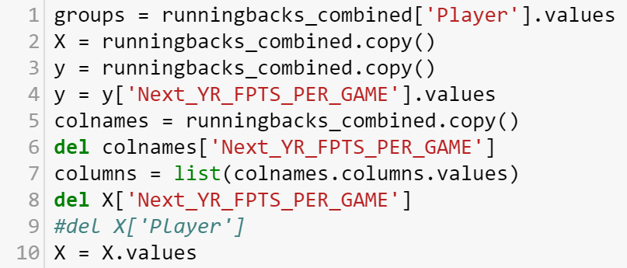
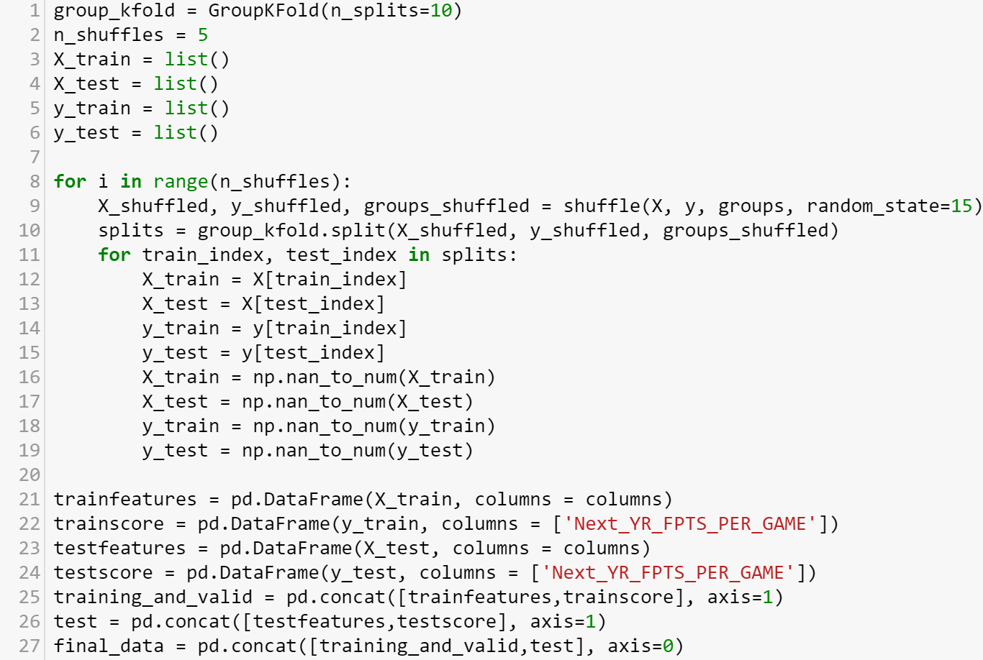
Case Study: Fantasy Football Draft
Group K-Fold Cross Validation: Create Test Set

Slide 25
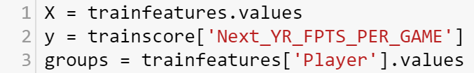
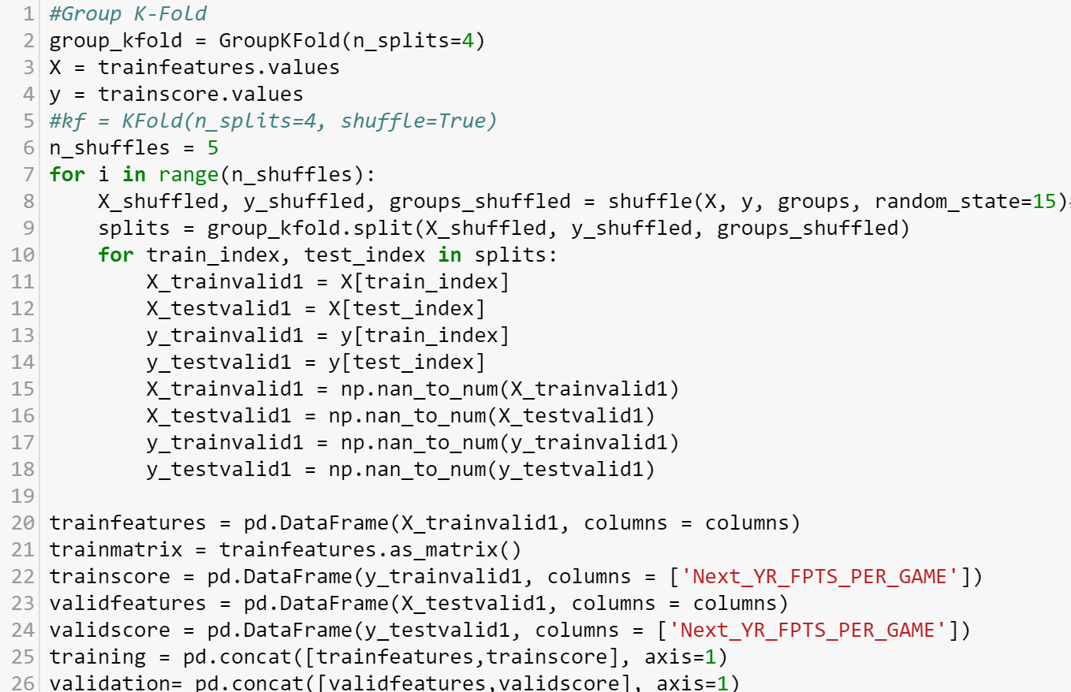
Case Study: Fantasy Football Draft
Group K-Fold Cross Validation: Create Training and Validation Sets

Slide 26
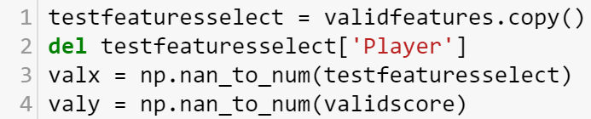
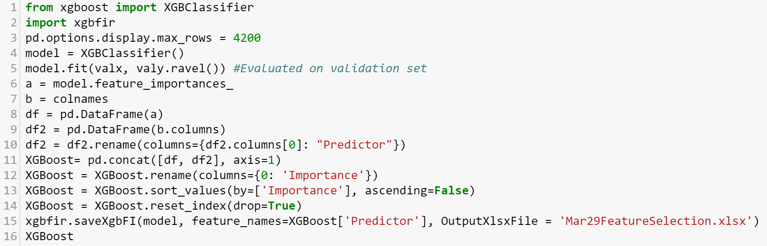
Case Study: Fantasy Football Draft
Feature Selection with XGBoost
The predictors from the Validation Set is Used

Slide 27
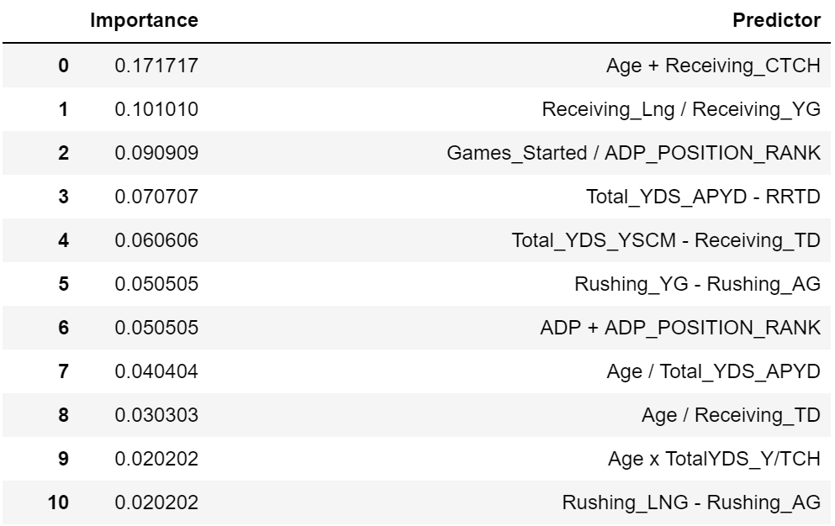
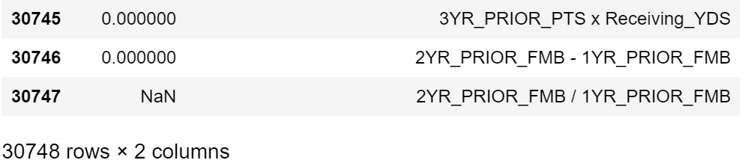
Case Study: Fantasy Football Draft
Feature Selection with XGBoost
Iteration 1

Slide 28
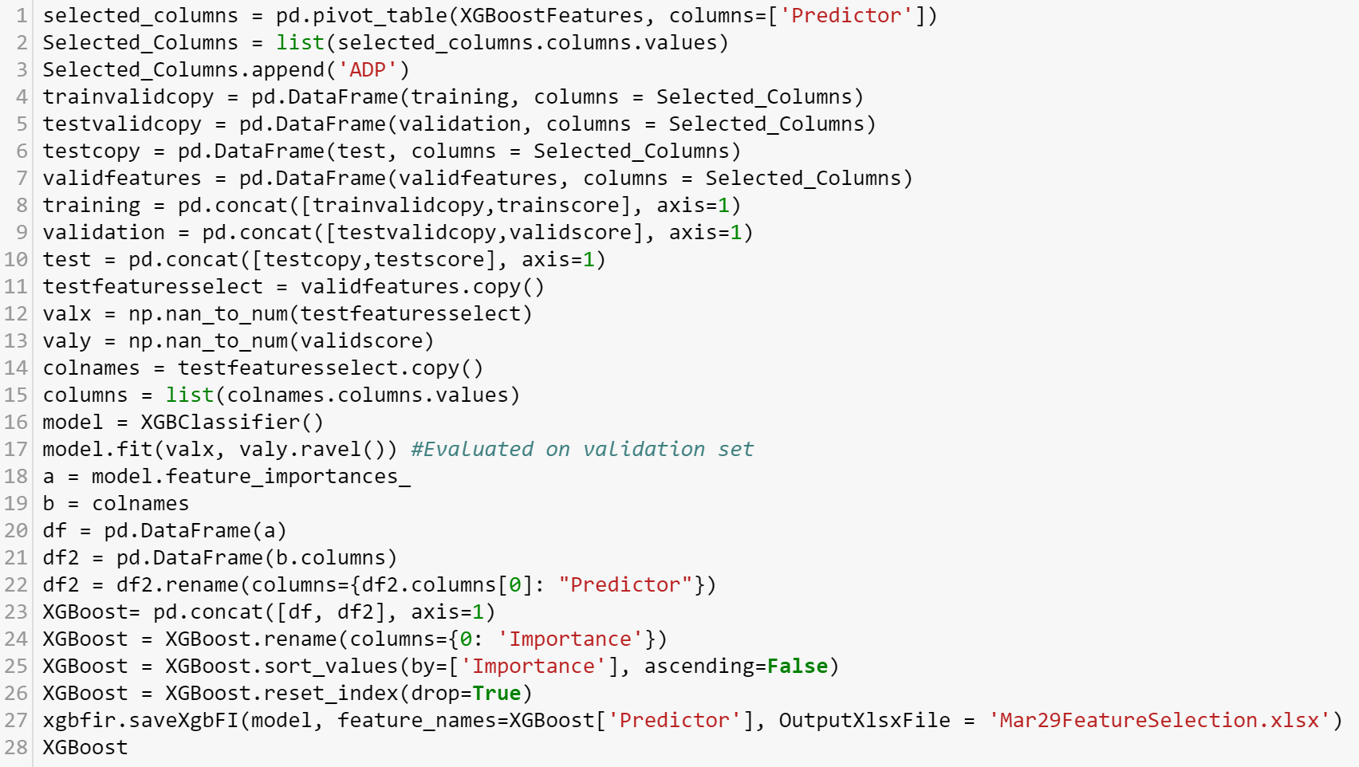
Case Study: Fantasy Football Draft
Feature Selection with XGBoost

Slide 29
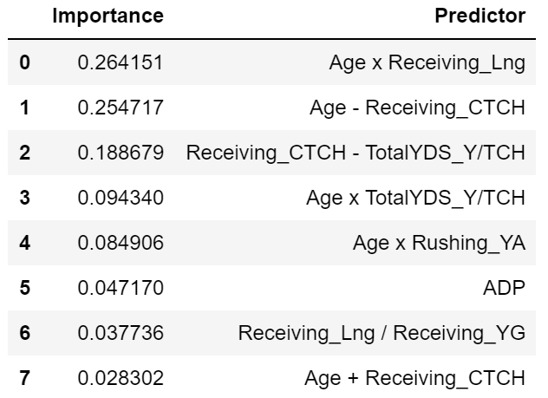
Case Study: Fantasy Football Draft
Feature Selection with XGBoost
The process of feature selection should be iterative.
If you cutoff too many features, you risk eliminating potentially important features, which initially had low variable importance rankings due to the presence of multi-collinearity
Notes:
Note, the most important feature in the running back model, was not even in the top 10 during the initial iteration.

Slide 30
SO… Which Running Backs Should I Draft?

Slide 31
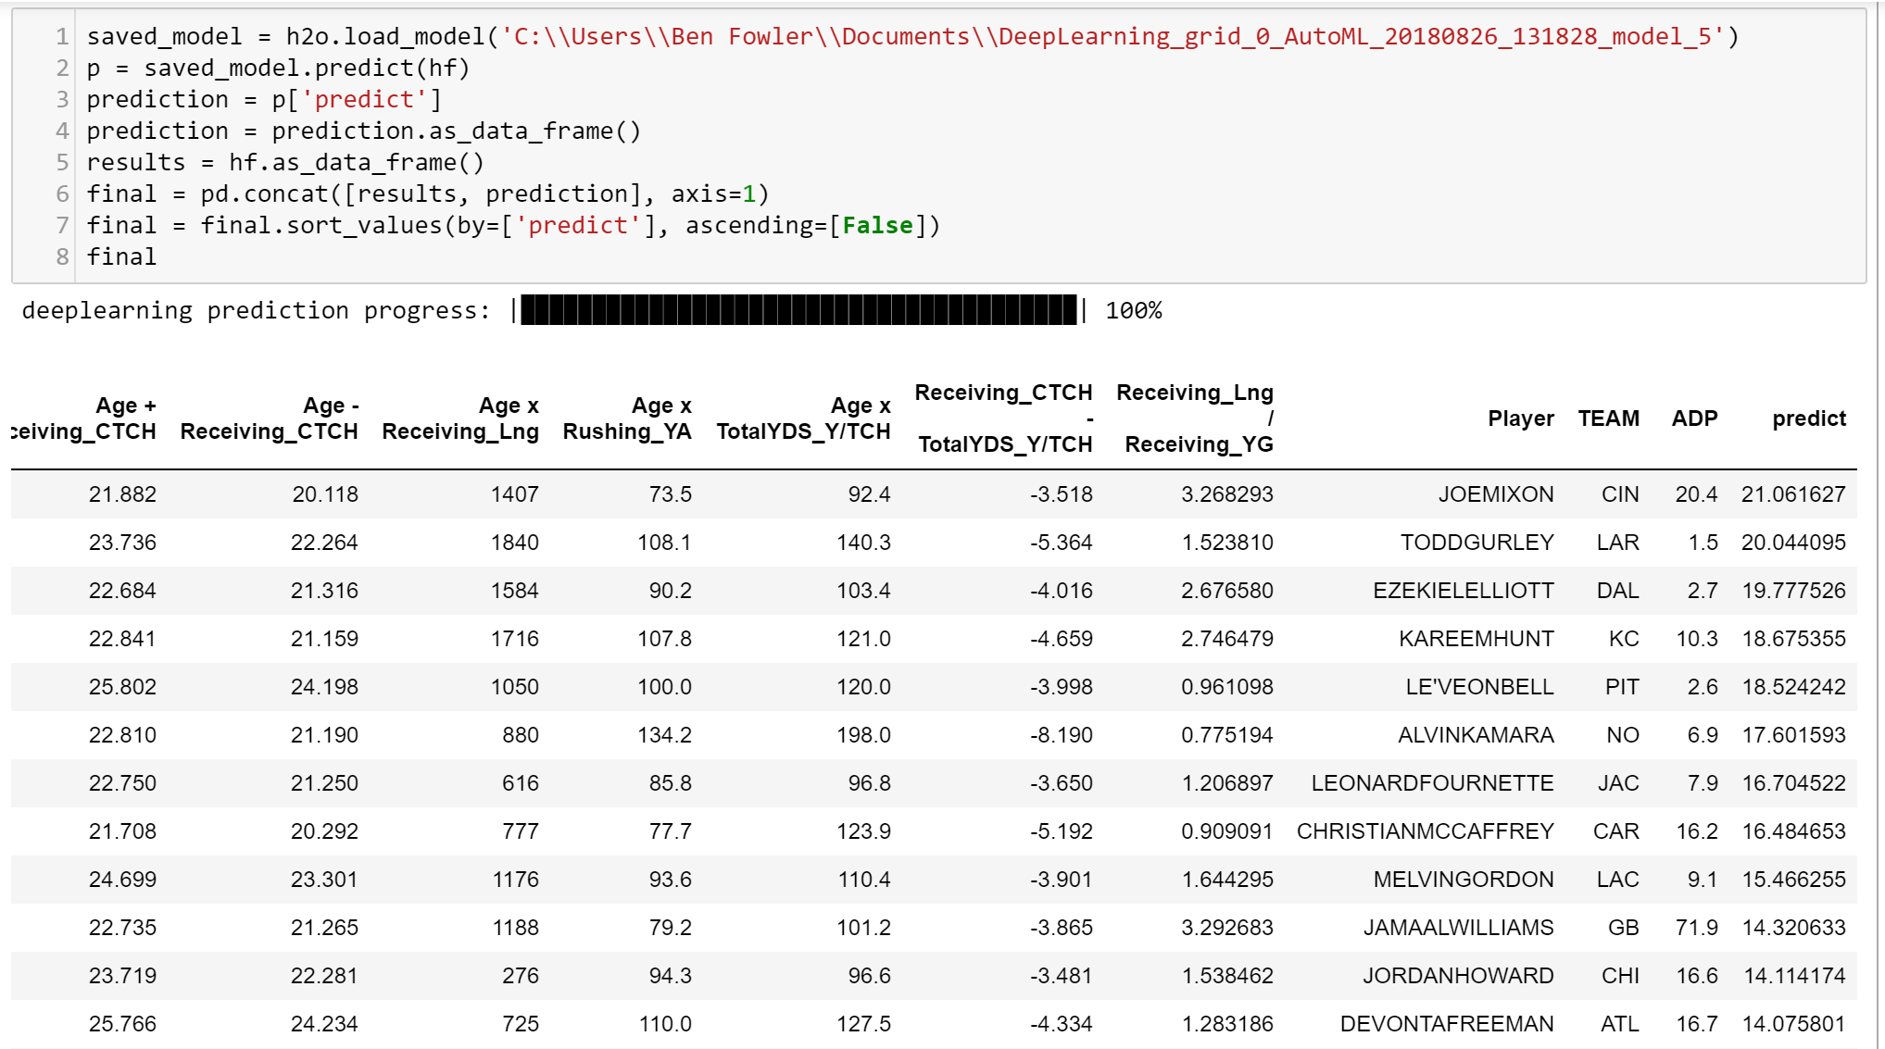
Case Study: Fantasy Football Draft
Modeling

Slide 32
CONTACT INFO
Website – jmfamily.com
Email – ben.fowler@jmfamily.com
We’re Hiring!!!

